Slide 1
Deep Learning
5. Convolutional Networks

Slide 2
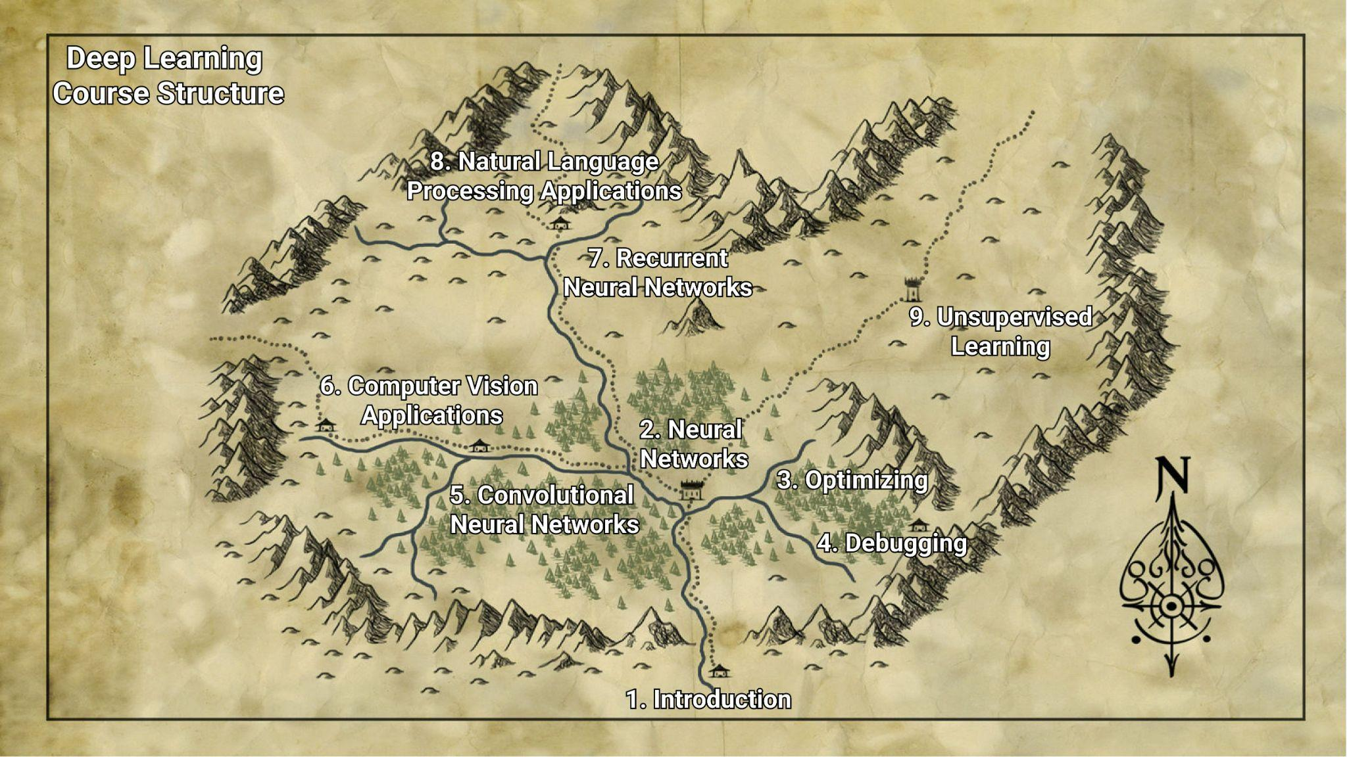

Slide 3
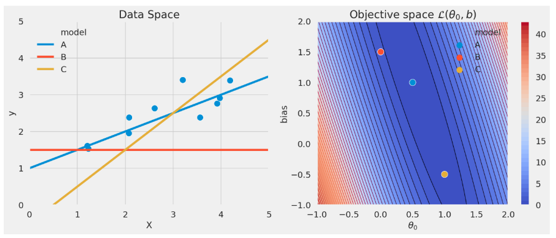
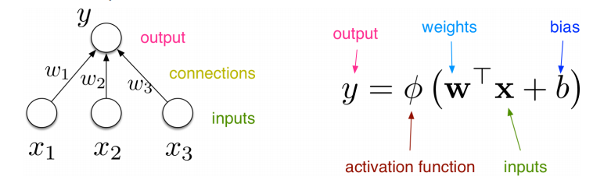
Recap

Slide 4
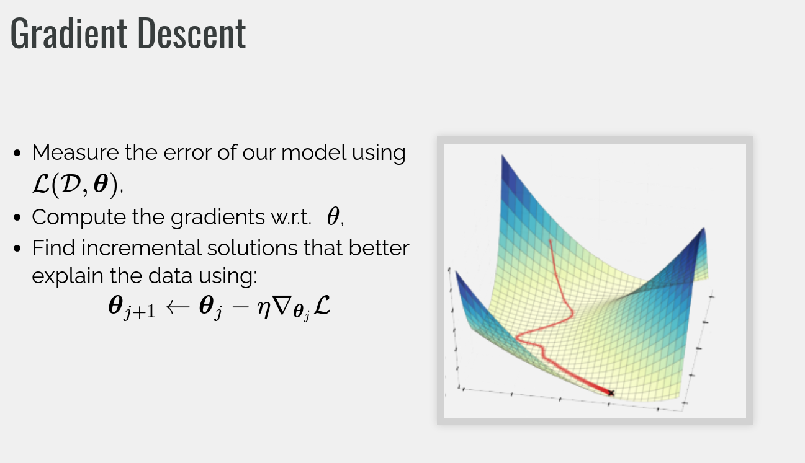

Slide 5
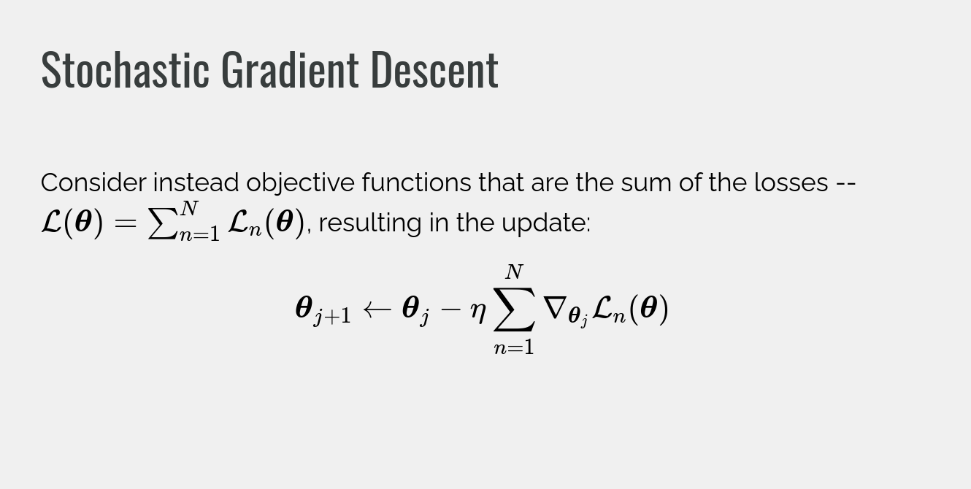

Slide 6
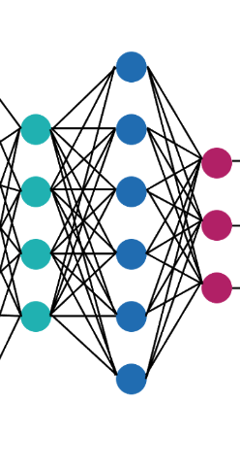
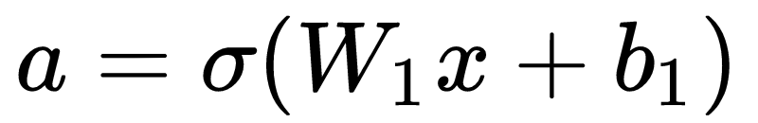
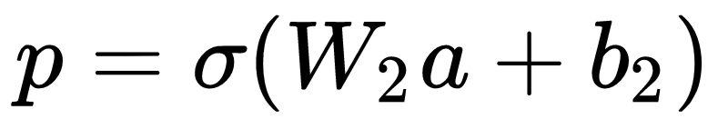
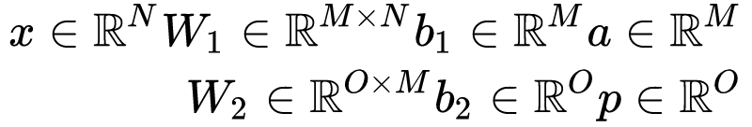
Recap: Fully connected networks
weights
activations
predictions
input

Slide 7
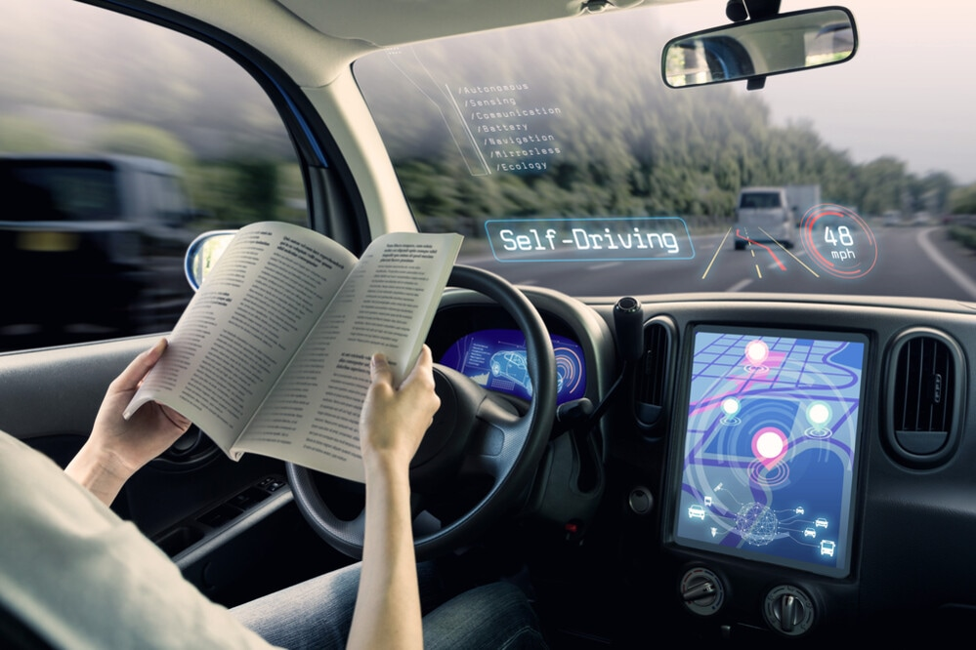
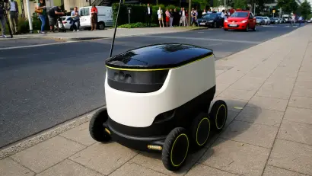
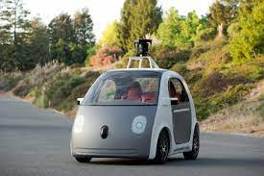
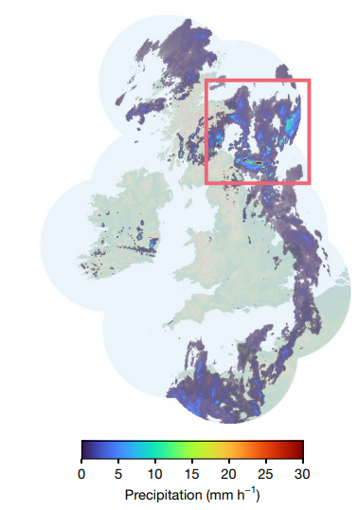
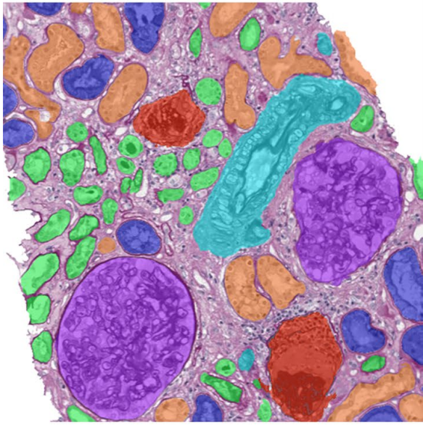
Visual Processing
Self-driving vehicles
Medical imaging
Weather forecasting
van der Laak et. al. Deep learning in histopathology: the path to the clinic. Nature 2021
Ravuri et al. Skilful precipitation nowcasting using deep generative models of radar. Nature 2021
Notes:
Medical imaging: https://www.nature.com/articles/s41591-021-01343-4
Weather forecasting: https://www.nature.com/articles/s41586-021-03854-z

Slide 8
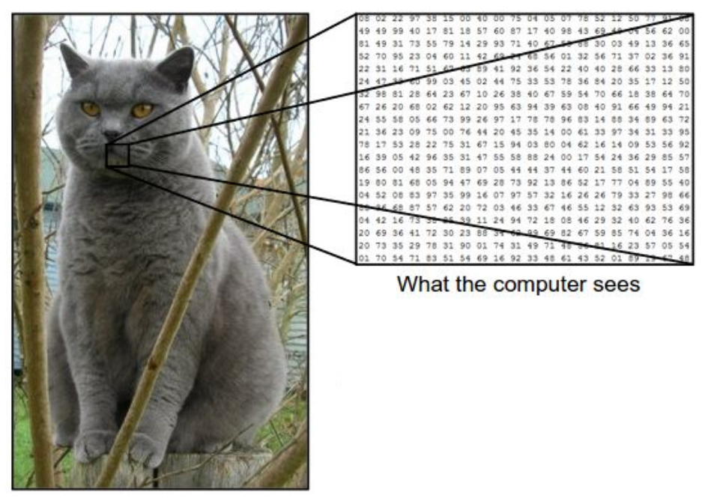
Process Images

Slide 9
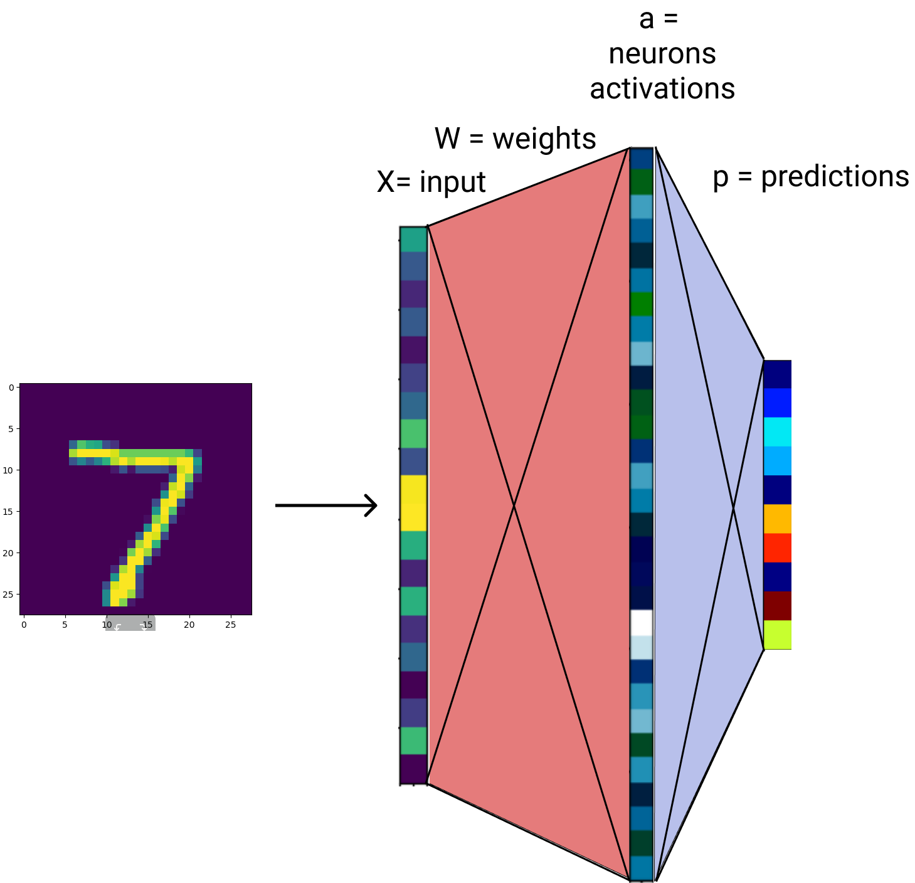
Process Images: How about fully connected networks?
Linearise image and treat it as a large vector
Process the image (vector) with fully connected network
Fully connected networks are universal approximators => they can represent anything

Slide 10
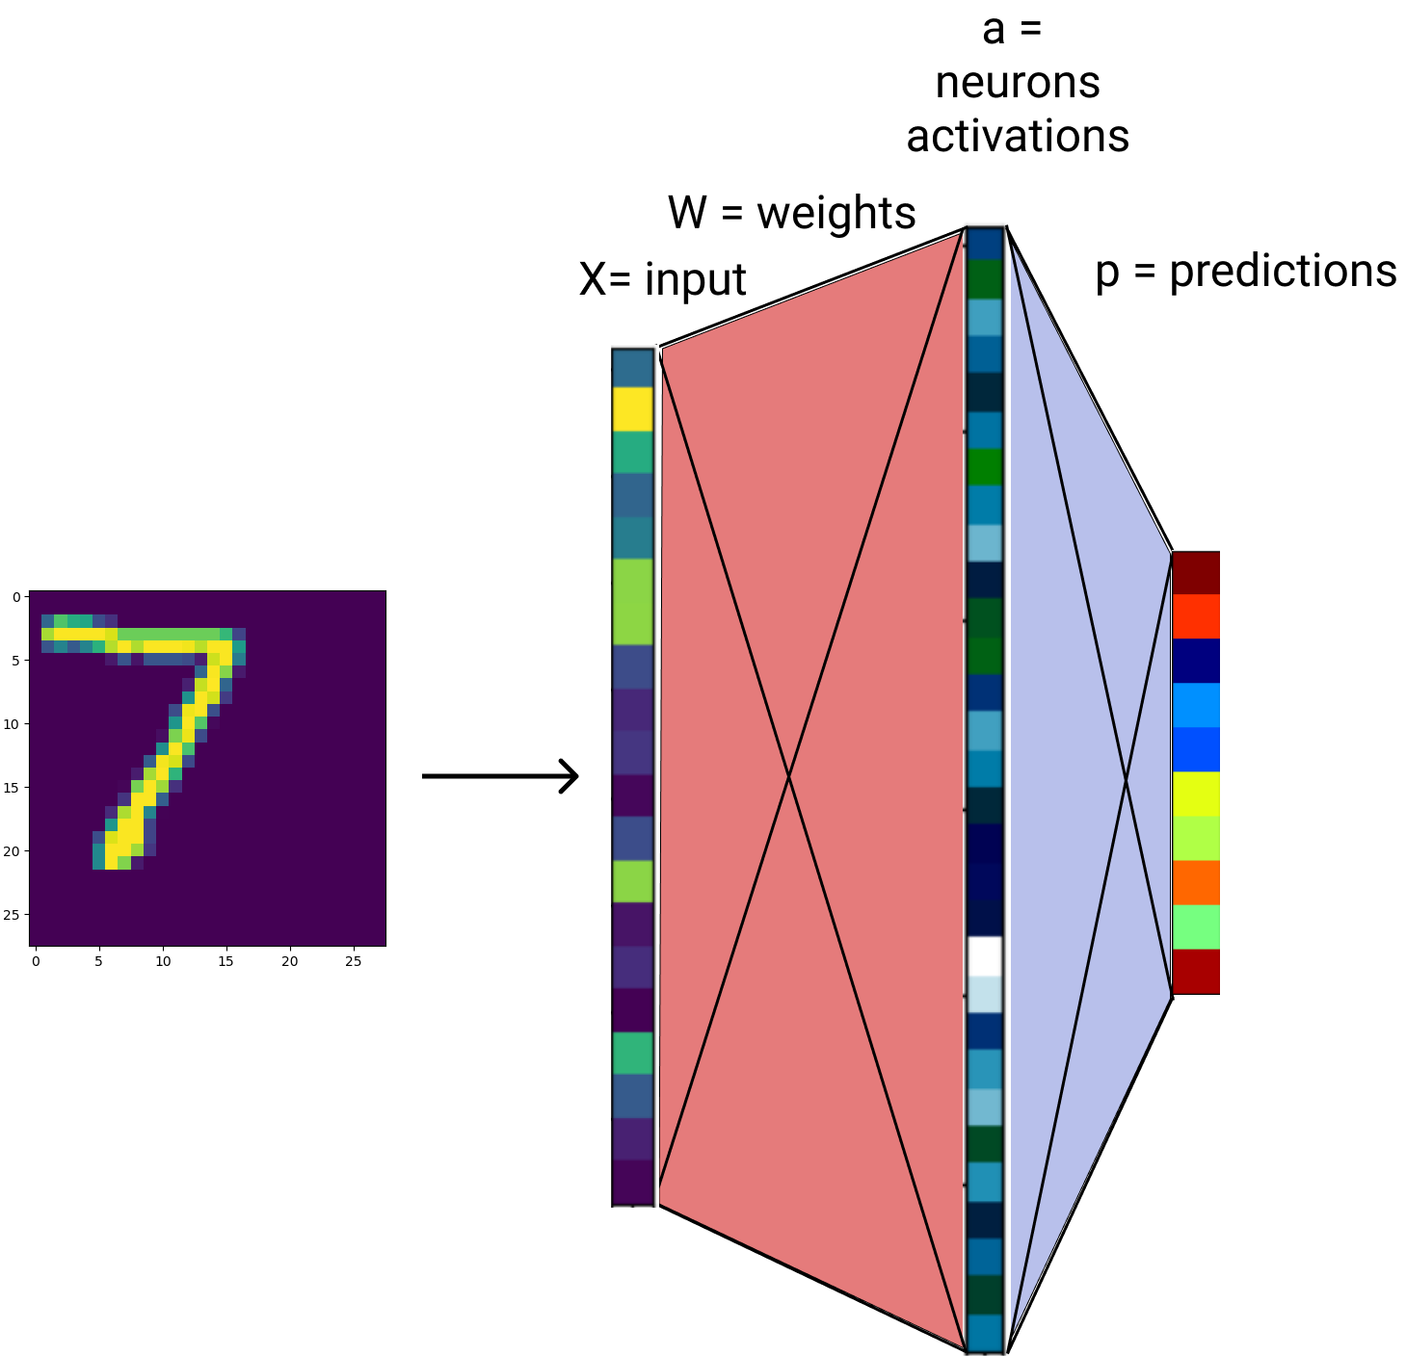
Process Images: Fully connected network
Linearise image and treat it as a large vector
Process the image (vector) with fully connected network
Fully connected networks are universal approximators => they can represent anything

Slide 11
Process Images: Fully connected network
Downsides:
Too MANY parameters
Different output for small translations
Every point is treated differently:
Network has to learn the same features for every location in the image
Inefficient:
In representation: it has to learn redundant features
In optimization: hard to train, requires a lot of training examples
Slow inference
Conclusion: inefficient

Slide 12
Process Images: Useful biases
Visual data has some useful biases:
Locality: for a pixel close neighbours are more important than distant ones
Stationarity: Same pattern has the same meaning regardless of position in the image
An architecture suited for processing visual data should incorporate these such inductive biases into its architecture.
Notes:
“Inductive bias describes the tendency for a system to prefer a certain set of generalizations over others that are equally consistent with the observed data.”
https://medium.com/flatiron-engineering/using-inductive-bias-as-a-guide-for-effective-machine-learning-prototyping-66e5468407a8
Battaglia et al. [2018]: Relational inductive biases, deep learning, and graph networks

Slide 13
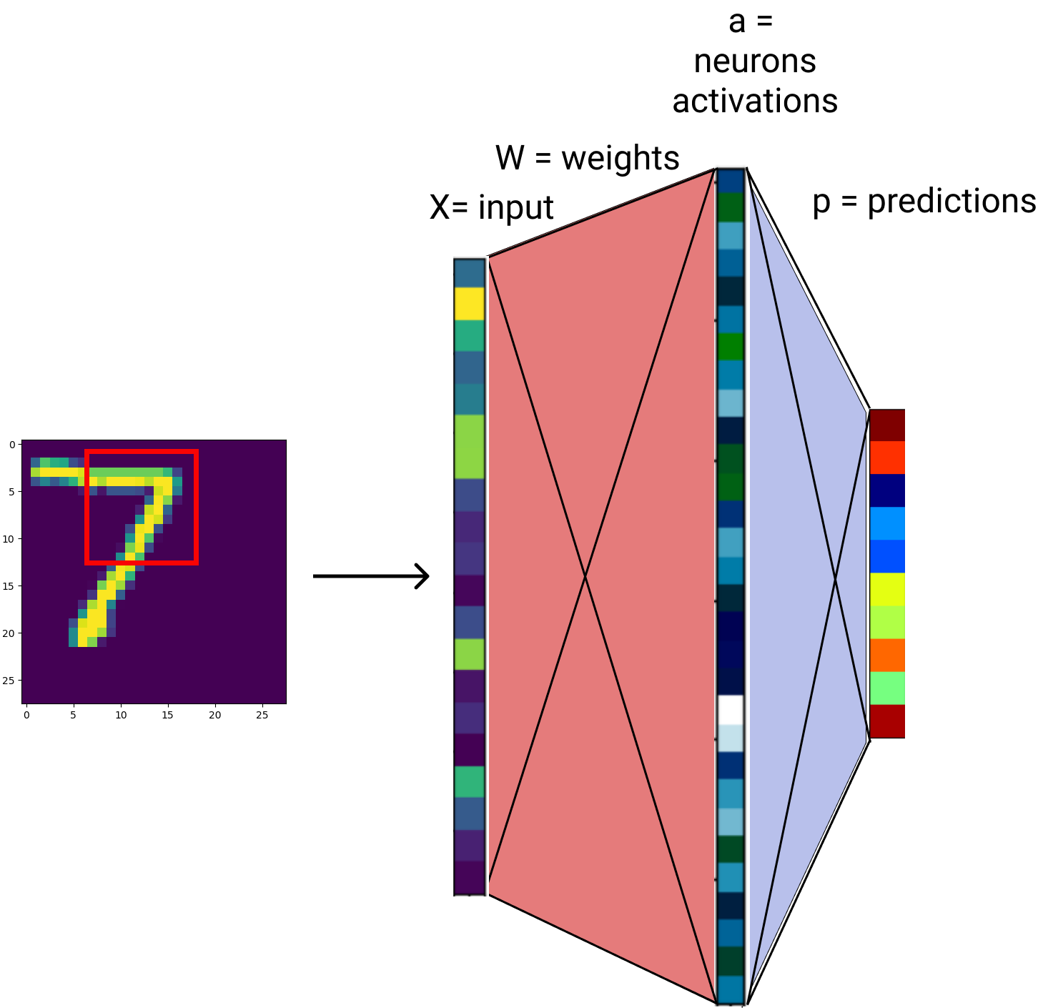
Process Images
To tackle these problems we will use an operation that is designed with the locality and stationarity properties in mind
Practically:
we restrict our operations to a small window
Apply a linear operation in that window (+ pointwise non-linearity)
Repeat the same process on every possible small window in the image

Slide 14
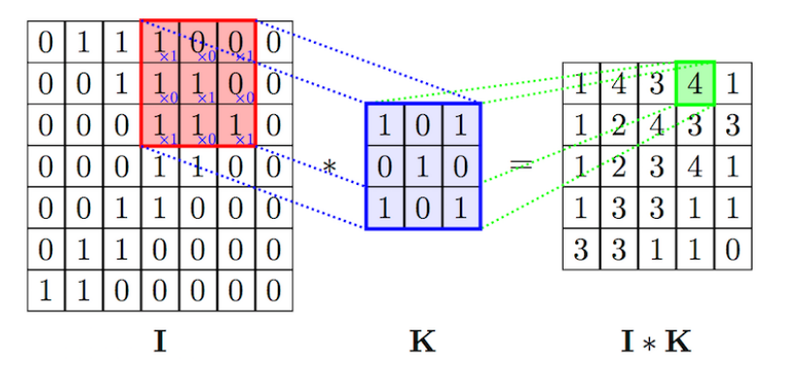
Convolution
Conv: Element-wise multiply the kernel and each patch and sum the result for every location
Can be interpreted as:
Search for a patch in the image that matches the kernel
Compute the matching for every location
Image from: https://anhvnn.wordpress.com/2018/02/01/deep-learning-computer-vision-and-convolutional-neural-networks/

Slide 15
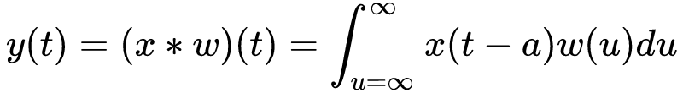
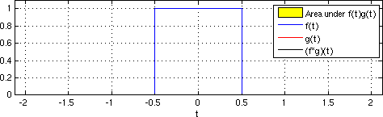
Convolution: continuous domain
For 1D continuous signals the convolution is defined as:
https://upload.wikimedia.org/wikipedia/commons/6/6e/Convolution_of_box_signal_with_itself.gif
Notes:
plus: la tabla aratat conv intre semnal si gaussian

Slide 16
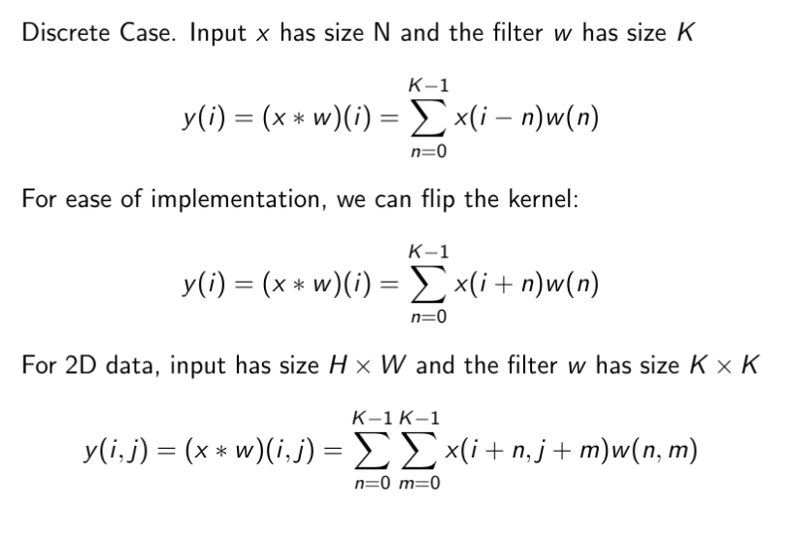

Convolution
Figure from https://github.com/vdumoulin/conv_arithmetic
Notes:
https://github.com/vdumoulin/conv_arithmetic

Slide 17
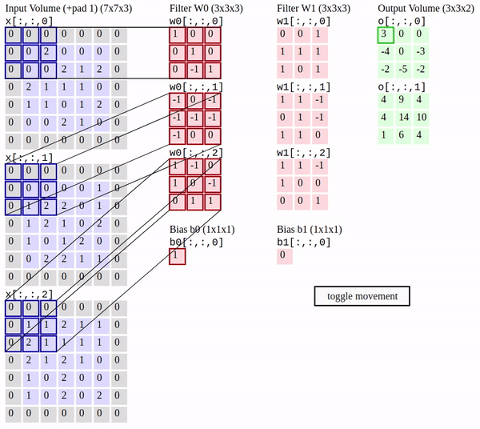
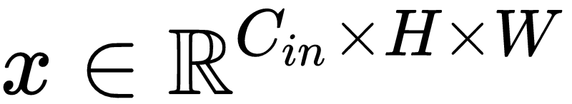
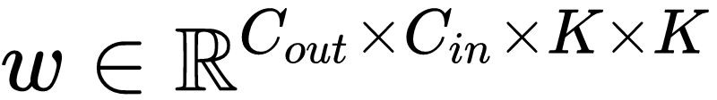
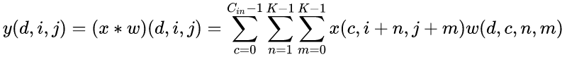
Convolutional Layer
The standard case for neural networks is having 2D inputs with multiple channels and kernels

Slide 18
Convolution
If the input has C channels
then each convolutional filter has C channels
Here we have 2 filter, each having size C x K x K = 3 x 3 x 3
In total:
Filter W has size 2 x C x K x K
Bias b has size 2
Image from: http://cs231n.github.io/convolutional-networks/

Slide 19
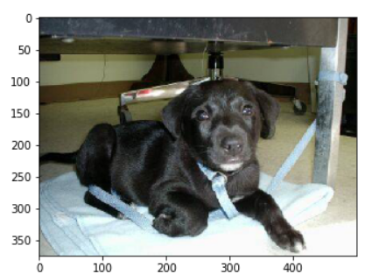
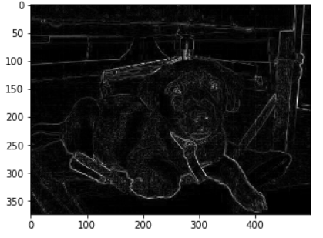
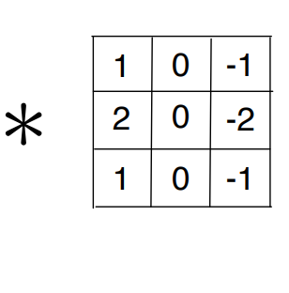
Convolution

Slide 20
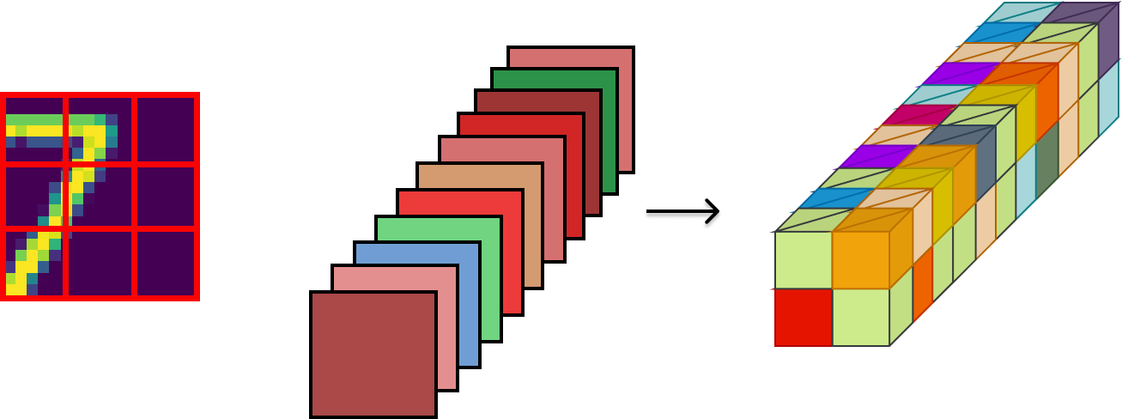

Convolutional Layer
Convolutional operation includes:
Input x (images)
Learnable Parameters named filters or kernels or weights
output feature map
Output feature map
Input
Kernels
Convolution operation

Slide 21
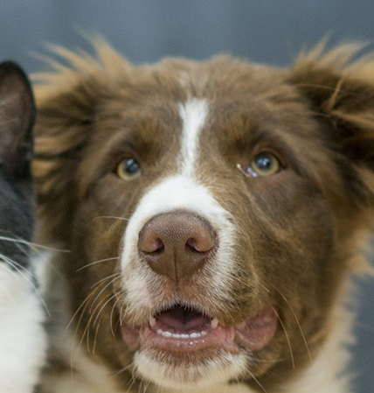
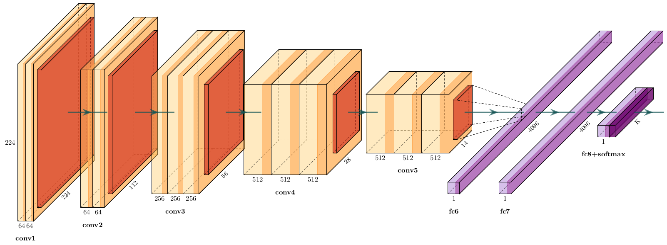
Convolutional Networks
A convolutional network is formed by stacking multiple convolutional layers, with non-linear activations in between. At the end, fully connected layers could be used.
Going from the first layers to the last, the features obtained by the network have different meanings. In the first layers they represent low-level features such as edges, textures, while in the upper layers the features could represent entities such as parts or whole objects
Edges -> textures -> entities

Slide 22
Convolutional Networks
A convolutional network is formed by stacking multiple convolutional layers, with non-linear activations in between. At the end, fully connected layers could be used.
Going from the first layers to the last, the features obtained by the network have different meanings. In the first layers they represent low-level features such as edges, textures, while in the upper layers the features could represent entities such as parts or whole objects
Edges -> textures -> entities

Slide 23
Convolutional Networks
A convolutional network is formed by stacking multiple convolutional layers, with non-linear activations in between. At the end, fully connected layers could be used.
Going from the first layers to the last, the features obtained by the network have different meanings. In the first layers they represent low-level features such as edges, textures, while in the upper layers the features could represent entities such as parts or whole objects
Edges -> textures -> entities

Slide 24
Recap - Convolutional operation
It is efficient because it takes advantage of properties of the data
Locality and stationarity
Appropriate for cases where the data has these properties:
Images, videos
Audio
Sequence of words
Any problem where spatial structure plays a key role
Keywords:
Learnable parameters: Kernel = filter + bias

Slide 25
Convolution
We will see how convolutions are applied in standard convolutional networks.
Introduce some key concepts
Figure from https://github.com/vdumoulin/conv_arithmetic
Notes:
https://github.com/vdumoulin/conv_arithmetic

Slide 26
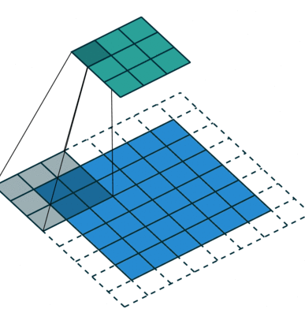
Convolution: Stride
Skip computations with a stride
Stride k: move each patch by k pixels
Reduces the resolution of the output
Figure from https://github.com/vdumoulin/conv_arithmetic

Slide 27
Convolution: Padding
Lose information at margins
The output features maps are smaller than the input
Solutions:
Apply padding to the input
Process margins separately with different kernels
Figure from https://github.com/vdumoulin/conv_arithmetic
Notes:
https://github.com/vdumoulin/conv_arithmetic

Slide 28

Convolution: Padding
Use padding half the filter size, to keep the output the same size as the input
Different kinds of padding:
Zero, reflexive
Figure from https://github.com/vdumoulin/conv_arithmetic
Notes:
https://github.com/vdumoulin/conv_arithmetic

Slide 29
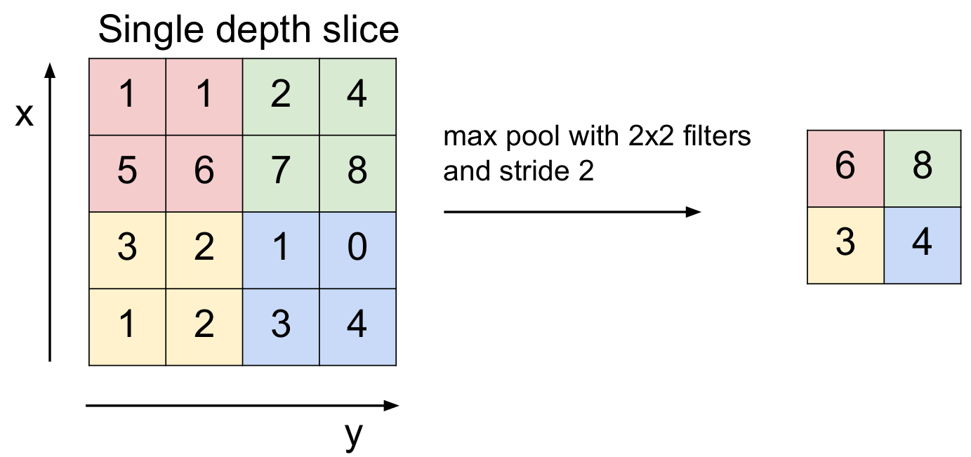
Pooling
From every patch output one value
Reduce output resolution:
Output is invariant to small local translations
Make the computation lighter
Pooling types: max, average
Figure from: CS231n Stanford Course

Slide 30
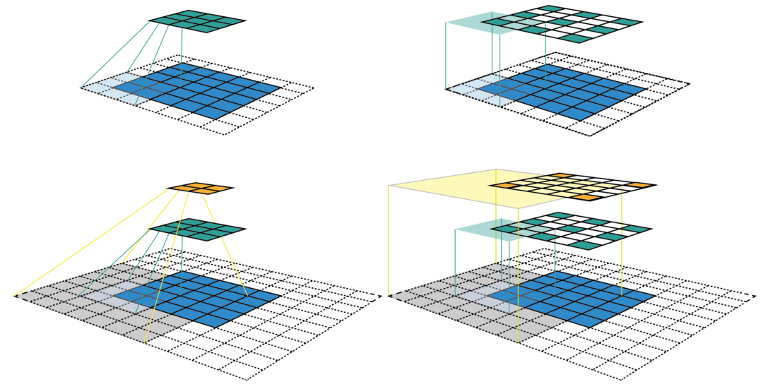
Receptive field
Receptive field of a point in a feature map:
Region of the image that influences that point
Receptive field grows:
linear with the number of layers with stride one
multiplicatively by using layers with stride > 1
linear with size of filters
Figure from: https://medium.com/mlreview/a-guide-to-receptive-field-arithmetic-for-convolutional-neural-networks-e0f514068807

Slide 31
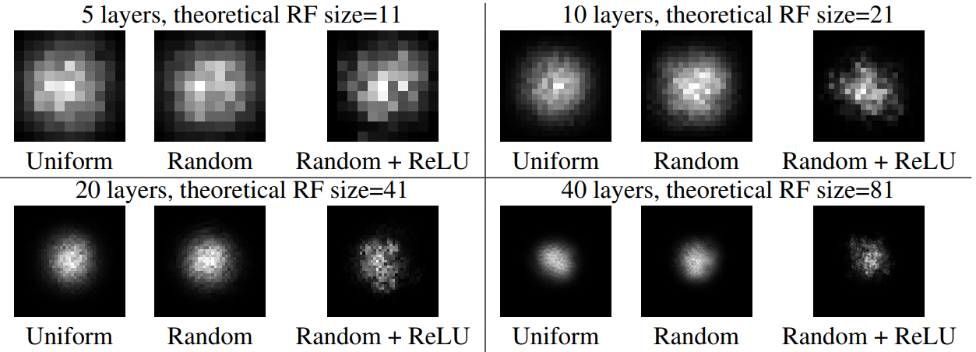
Effective Receptive field
Effective Receptive field of a point in a feature map:
Region of the image that influences that point in a non-negligible way
effective receptive field only takes up a fraction of the full theoretical receptive field
distribution of effective receptive field: asymptotically Gaussian
Effective Receptive Field
Figure from: Luo et. al: Understanding the effective receptive field in deep convolutional neural networks

Slide 32
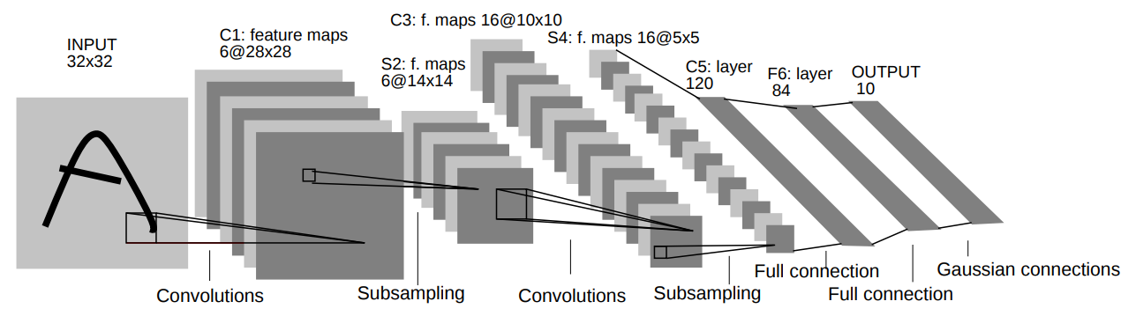
Convolutional Networks in 1998: LeNet-5
LeCun et al. [1998]: Gradient-based learning applied to document recognition

Slide 33
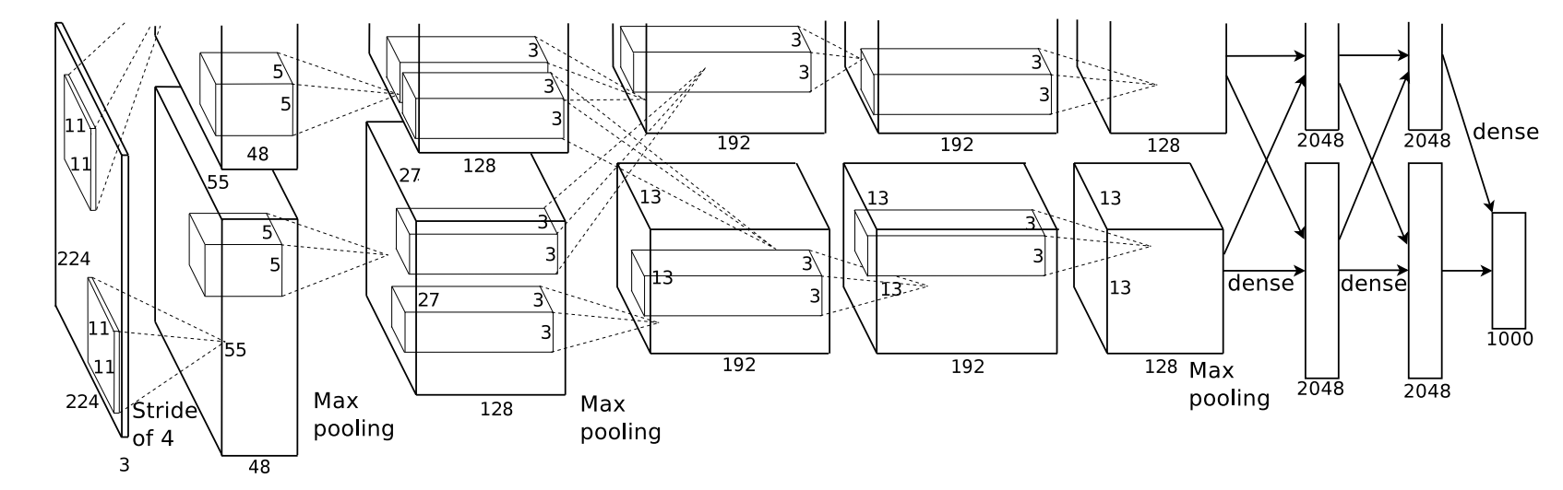
Convolutional Networks in 2012: AlexNet - DL revolution
fast conv nets implemented on GPU started to obtain superior results: DanNet [2011] - AlexNet [2012]
By winning the 2012 ImageNet competition AlexNet is considered to have triggered a revolution in ML, starting the current wave of Deep Learning methods
Krizhevsky et al. [2012]: Imagenet classification with deep convolutional neural networks
Dan Cireșan, U Meier, J Schmidhuber [2011]: Multi-column Deep Neural Networks for Image Classification

Slide 34
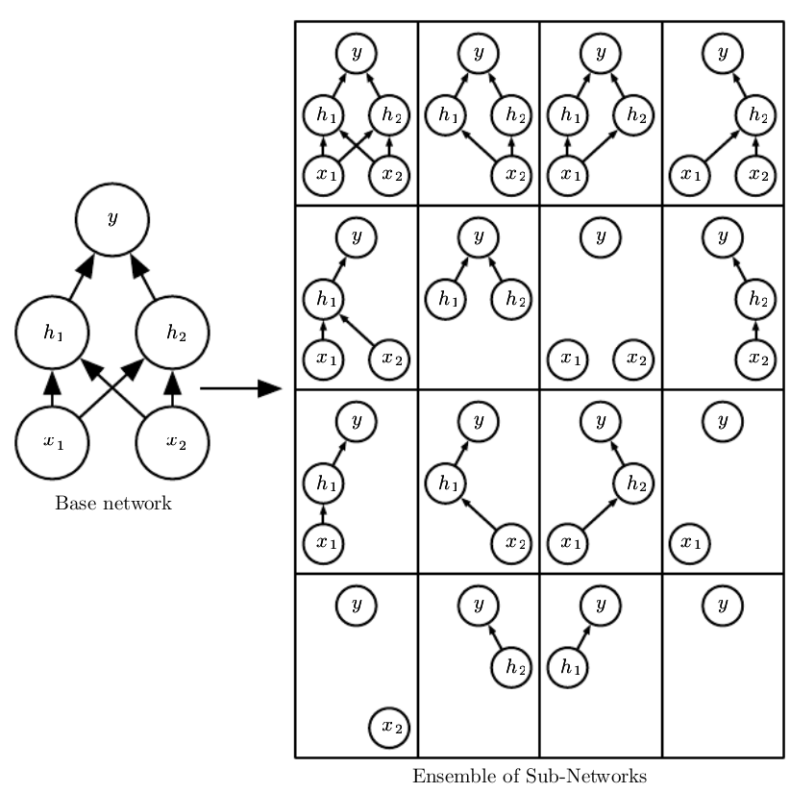
Dropout
At each step in the optimisation algorithm make 50% of neuron activations zero
At testing time (inference) use all the output but scaled with 0.5
Reduces overfitting by regularise the network
Make each neuron not relying on fixed features
=> more robust model
Create implicit ensemble of subnetworks
Image from: I. Goodfellow et. al: Deep Learning book

Slide 35
Regularization
Any strategy used to reduce its generalization error but not the training error
Constraints and penalties designed to encode prior knowledge or to impose preference towards simpler models in order to promote generalization
General Regularizations:
Weight decay: L2 or L1 penalties of parameters norm
Dropout
More data / Data augmentation
Adding noise: to input / activations / weights / labels
Early Stopping
Implicit Convolutional Regularizations:
Weight sharing across locations
Local / gaussian effective receptive fields

Slide 36
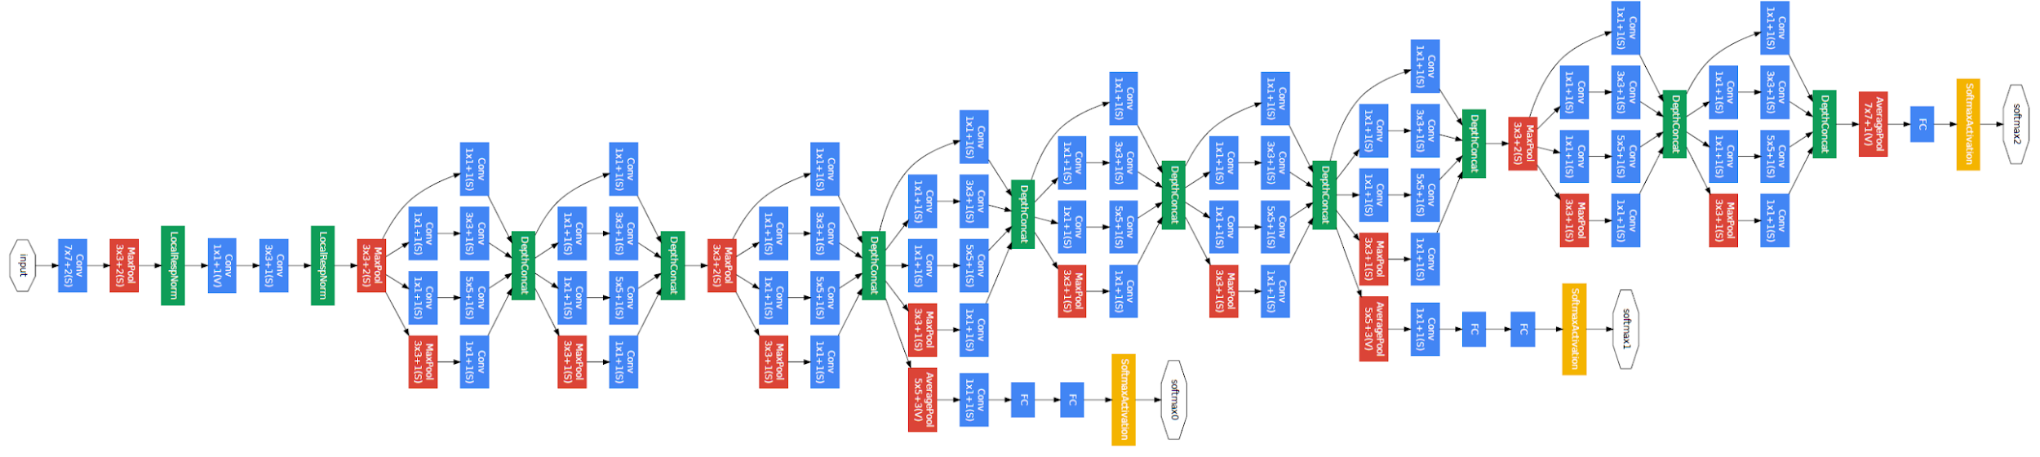
Convolutional Networks in 2014: GoogleNet - Inception V1
Core principles:
efficient utilization of the computing resources
multi-scale processing inside the network
Results
ImageNet ILSVRC14 winner (6.7% top 5 error)
12x less parameters than AlexNet while significantly more accurate
Szegedy et al. [2015]: Going deeper with convolutions

Slide 37
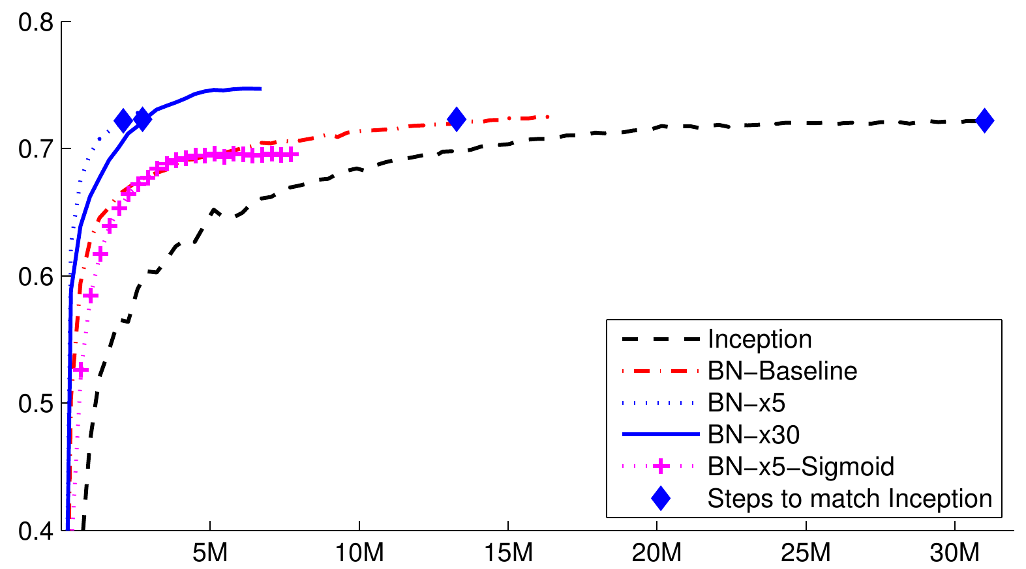
Convolutional Networks in 2015: Inception - v2
Use Batch Norm
Ioffe and Szegedy [2015]: Batch normalization: Accelerating deep network training by reducing internal covariate shift.

Slide 38
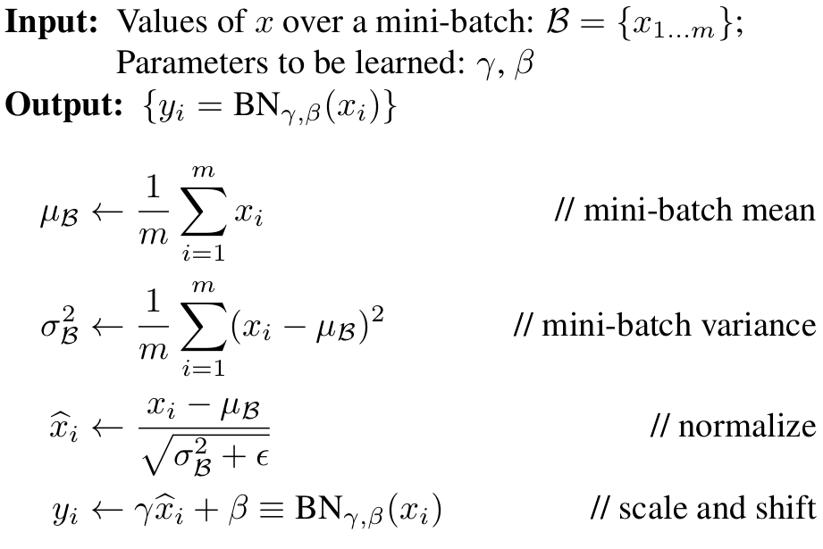
Batch Norm
Different kinds of normalisation
Batch Norm for Vision - ConvNets
Layer Norm for NLP & CV - recurrent Nets, Transformers, GNNs
Spectral Norm for RL
Ba et.al. Layer Normalization. 2016
Gogianu et. al: Spectral Normalisation for Deep Reinforcement Learning: An Optimisation Perspective. ICML 2021

Slide 39
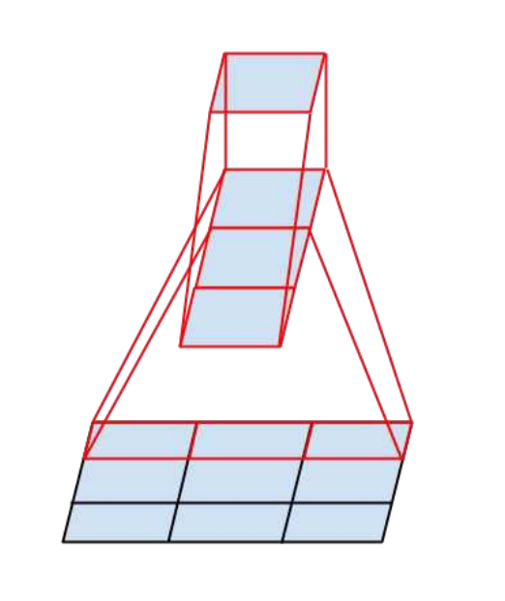
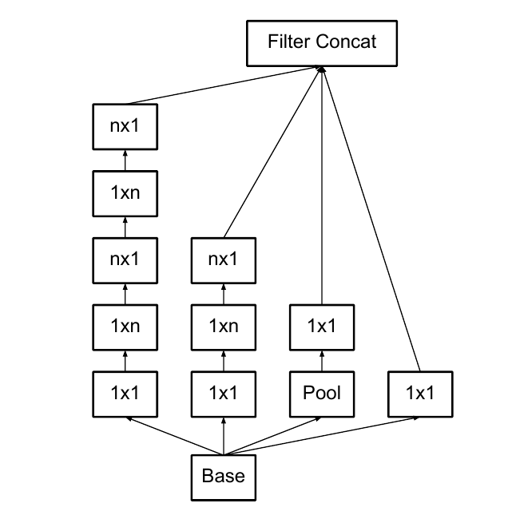
Convolutional Networks in 2016: Inception - v3
Factorise the convolutions
Replace N x N kernels with N x 1 and 1 x N kernels
Reduces computations
Acts as a regularization
Szegedy et al. [2016]: Rethinking the inception architecture for computer vision

Slide 40
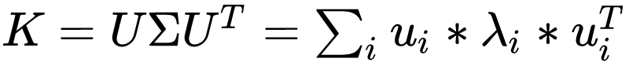

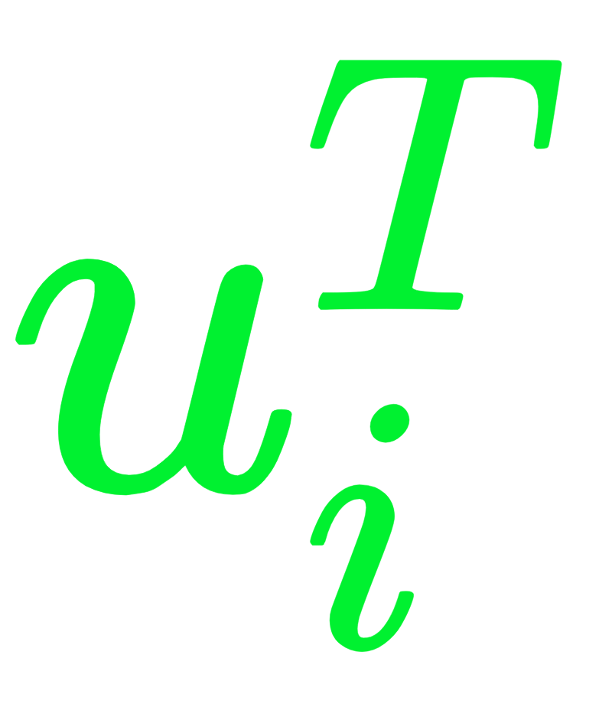

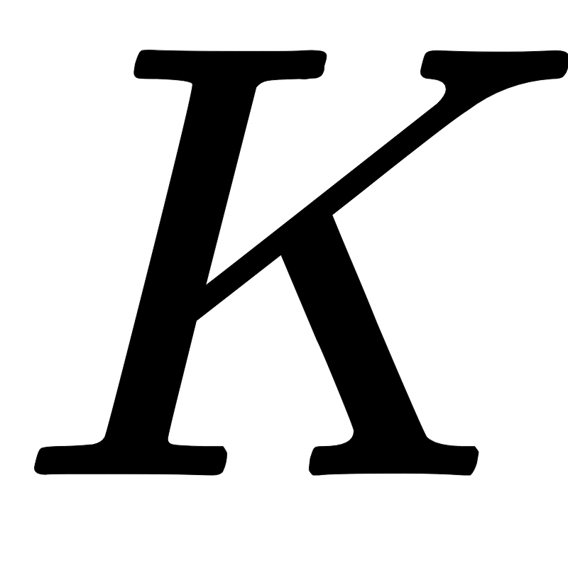

Kernel Factorisation: SVD motivation

Slide 41
Kernel Factorisation: SVD motivation
An N x N matrix is decomposed in maximum N vector outer products
By using fewer we arrive at a low rank matrix:
Fewer computations
Better regularisation
In practice, same representation power

Slide 42
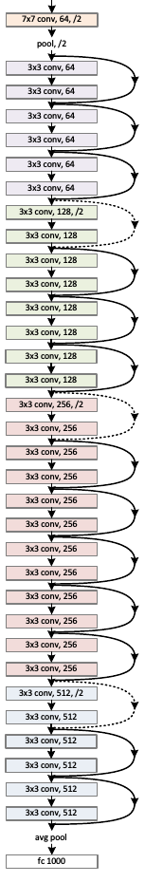
Convolutional Networks in 2016: ResNet
Core principles:
Train deeper models
Easily optimise by allowing direct paths between lower and upper levels
He et al. [2016]: Deep residual learning for image recognition

Slide 43
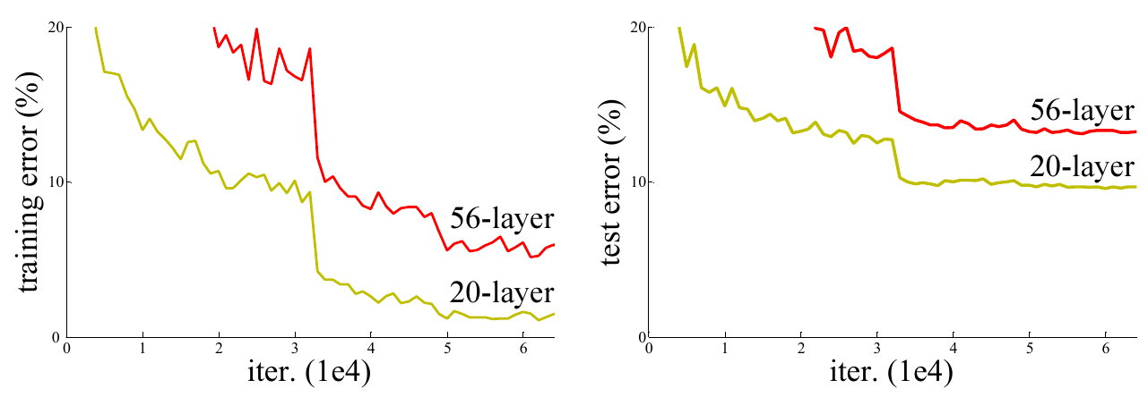
Convolutional Networks in 2016: ResNet
Deep ‘plain’ networks obtain worse results by increasing the number of layers
Cause:

Slide 44
Convolutional Networks in 2016: ResNet
Deep ‘plain’ networks obtain worse results by increasing the number of layers
Cause: Overfit? NO
Optimization problem

Slide 45
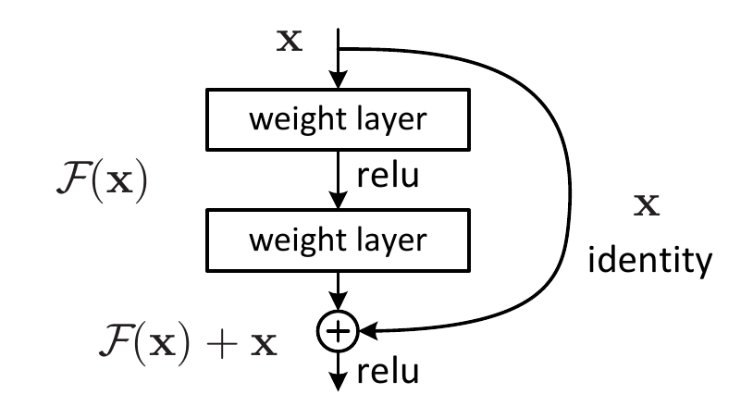
Convolutional Networks in 2016: ResNet
Add skip connections between between layers
The representation power of the network remains the same
The network can easily learn identity mapping
The optimisation is easier

Slide 46

Convolutional Networks in 2016: ResNet
Without BN
With BN
Effect of the residual connections
Deeper models can be trained and can improve shallower models

Slide 47


Convolutional Networks Analysis
Canziani et al. [2016]: An analysis of deep neural network models for practical applications.
Liu et. al. [2022]: A ConvNet for the 2020s + Lucas Beyer correction https://twitter.com/giffmana/status/1481054929573888005

Slide 48

Future of Convolutions in Visual Processing
Newer methods like Transformers and MLP-Mixers can bring benefits like long-range connection
Are still based on the same principles of
Locality
Stationarity
Tolstikhin et al. [2021]: MLP-Mixer: An all-MLP Architecture for Vision

Slide 49

Recap:
Basic components remained stable
In the last 10 years we added
Deeper and bigger architectures trained by SGD on GPUs
Better regularisation: dropout, batch norm
Better optimisation: skip connection, adam
More efficient use of params: factorisations
Deep Neural Nets: 33 years ago and 33 years from now https://karpathy.github.io/2022/03/14/lecun1989/

Slide 50
Inductive biases of CNNs
Convolutional networks are suited for visual tasks because they have inductive biases implicit in their architecture, that makes representing and learning the visual data more easily
Locality
Translation equivariance - (same output regardless of position)
For visual data, CNN are more efficient than fully connected layer
But how much training is really necessary?
In some cases, tasks could be solved by learning just a small fraction of the parameters (but this is not the norm..)

Slide 51


Training BatchNorm and Only BatchNorm
Batch Norm
Train only the scale and shift (gamma, beta) parameters of BN and keep randomly initialized all the other parameters of the network
‘Surprisingly’ good results
Frankle et al. [2020] Training BatchNorm and Only BatchNorm: On the Expressive Power of Random Features in CNNs
Notes:
Frankleet al. [2020] Training BatchNorm and Only BatchNorm: On the Expressive Power of Random Features in CNNs

Slide 52


Restore Images without training
Generate an image starting from random noise vector
Optimize a convolutional network to generate an image close to the input
Without training on any other images, just optimize on the single input
Takes advantage of the inductive biases of the model to produce probable images
Ulyanov et al. [2018] Deep Image Prior

Slide 53

New task: Classify image as cat or dog
Kaggle competition: https://www.kaggle.com/c/dogs-vs-cats-redux-kernels-edition

Slide 54


Cats vs Dogs
Deep ConvNets to the rescue
First approach:
Train Resnet or Inception from scratch on all available dogs and cats data
Downsides:
Require large amount of data
Long training time

Slide 55
Transfer Learning
When learning a new skill, humans reuse knowledge and practices that they already learned before.
when learning physics we use knowledge learned from mathematics
when learning to play ukulele we benefit from already playing guitar
How can we made ML models benefit from previously learned tasks?
Start with good representations of data
This could be given by a model already learned on a previous task
Build new representations for a new problem, by building on the old representations

Slide 56
Transfer Learning
In practice, for computer vision tasks
Start from a pretrained model on another task
With large amount of data
The previous task should be similar to the new task
Remove the prediction layer
Usually, the last layer is useful just for the old task
Build a new model by adding one or more layer to the model
Train the new model on the new task
Learn only the new layers (if the task is very similar) or
Learn the parameters of the entire model (fine-tunning)

Slide 57
Thank you!
(Next: NN applications for Computer Vision)

Slide 58
Other Resources
http://cs231n.github.io/convolutional-networks/
http://cs231n.github.io/transfer-learning/

Slide 59
References
A. Canziani, A. Paszke, and E. Culurciello. An analysis of deep neural network models for practical applications. arXiv preprint arXiv:1605.07678, 2016.
Frankle, J., Schwab, D.J. and Morcos, A.S., 2020. Training BatchNorm and Only BatchNorm: On the Expressive Power of Random Features in CNNs. arXiv preprint arXiv:2003.00152.
I. Goodfellow, Y. Bengio, and A. Courville. Deep Learning. MIT Press, 2016. http://www.deeplearningbook.org.
K. He, X. Zhang, S. Ren, and J. Sun. Deep residual learning for image recognition. In Proceedings of the IEEE conference on computer vision and pattern recognition, pages 770–778, 2016.
S. Ioffe and C. Szegedy. Batch normalization: Accelerating deep network training by reducing internal covariate shift. In Proceedings of the 32Nd International Conference on International Conference on Machine Learning - Volume 37,ICML’15, pages 448–456. JMLR.org, 2015.
A. Krizhevsky, I. Sutskever, and G. E. Hinton. Imagenet classification with deep convolutional neural networks. In Advances in neural information processing systems, pages 1097–1105, 2012.
Y. LeCun, L. Bottou, Y. Bengio, P. Haffner, et al. Gradient-based learning applied to document recognition. Proceedings of the IEEE, 86(11):2278–2324, 1998.

Slide 60
References
W. Luo, Y. Li, R. Urtasun, and R. Zemel. Understanding the effective receptive field in deep convolutional neural networks. In Advances in neural information processing systems
K. Simonyan and A. Zisserman. Very deep convolutional networks for large-scale image recognition. arXiv preprint arXiv:1409.1556, 2014.
C. Szegedy, W. Liu, Y. Jia, P. Sermanet, S. Reed, D. Anguelov, D. Erhan, V. Vanhoucke, and A. Rabinovich. Going deeper with convolutions. In Proceedings of the IEEE conference on computer vision and pattern recognition, pages 1–9, 2015.
C. Szegedy, V. Vanhoucke, S. Ioffe, J. Shlens, and Z. Wojna. Rethinking the inception architecture for computer vision. In Proceedings of the IEEE Conference on Computer Vision and Pattern Recognition, pages 2818–2826, 2016.
Ulyanov, D., Vedaldi, A. and Lempitsky, V., 2018. Deep image prior. In Proceedings of the IEEE Conference on Computer Vision and Pattern Recognition (pp. 9446-9454).

